Slide 1














PERSONAL FINANCE MANAGEMENT SYSTEM
PROFESSOR:
CONTRIBUTORS:
MANUEL MONTROND
SRIKANTH NANDIKONDA
SAIPRANATH GOPATHI
MEET BHANUSHALI
MANSI THORAT
SREERAM CHARAGUNDLA

Slide 2

Overview
The Personal Finance Management System is a database project facilitating intuitive tracking of income, expenses, and investments. Employing a robust relational database with encryption and access controls ensures secure data handling. Users can efficiently manage expenses, budgets, and investment portfolios, accessing customizable reports for a comprehensive financial snapshot. The project empowers individuals to make informed financial decisions and sets the stage for scalability and future enhancements, making it an invaluable tool for personalized financial management

Slide 3

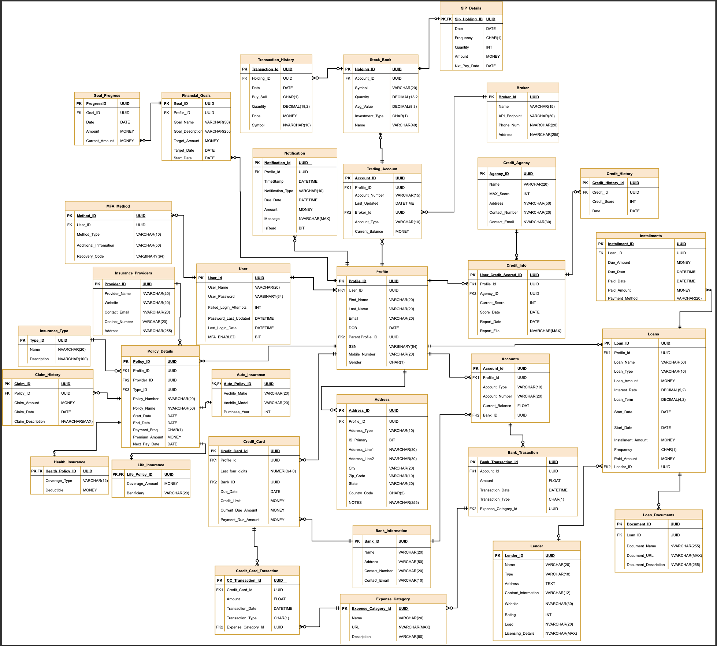
ERD

Slide 4
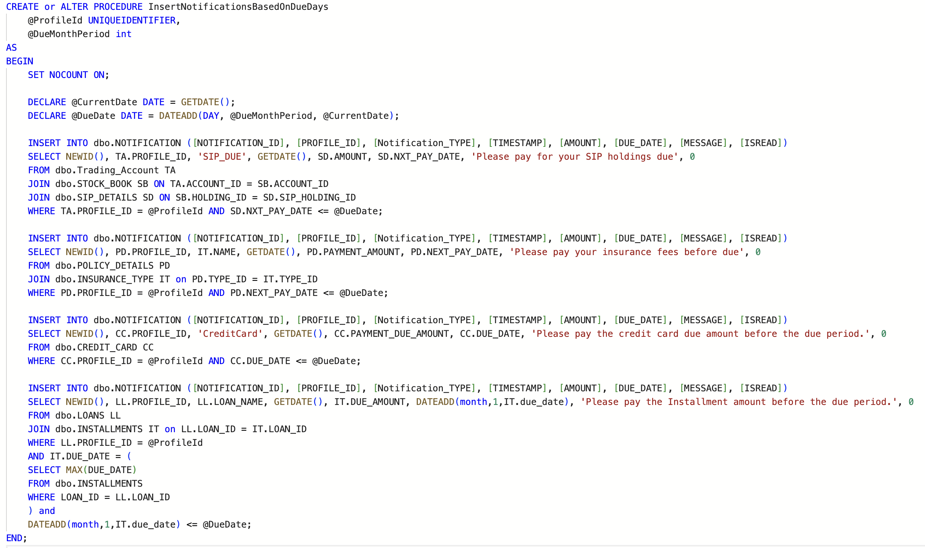
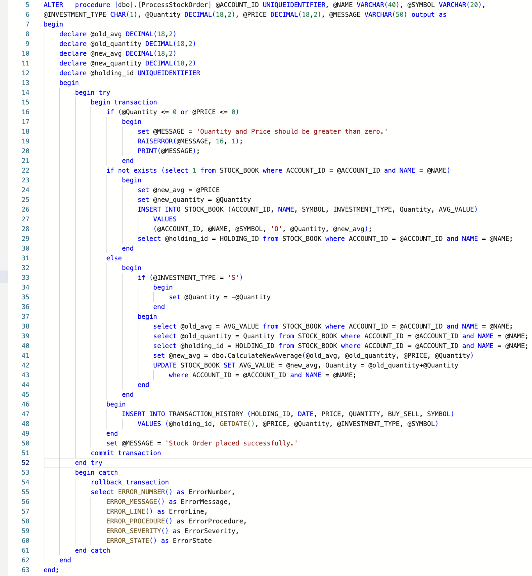

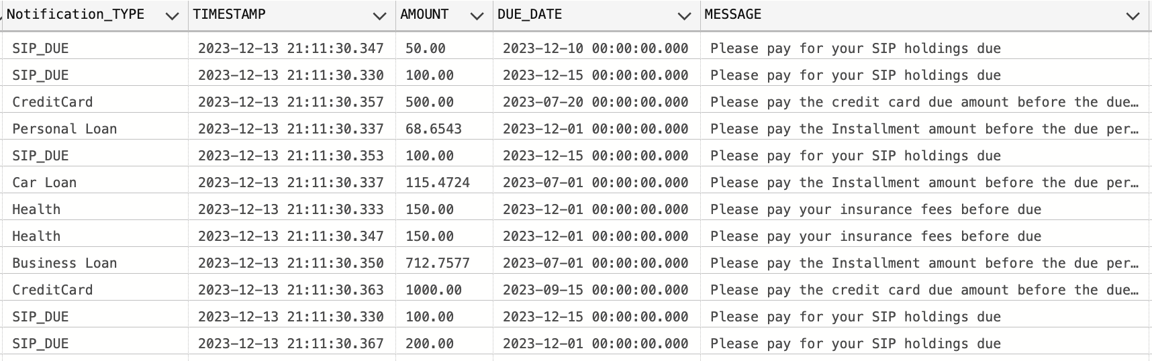
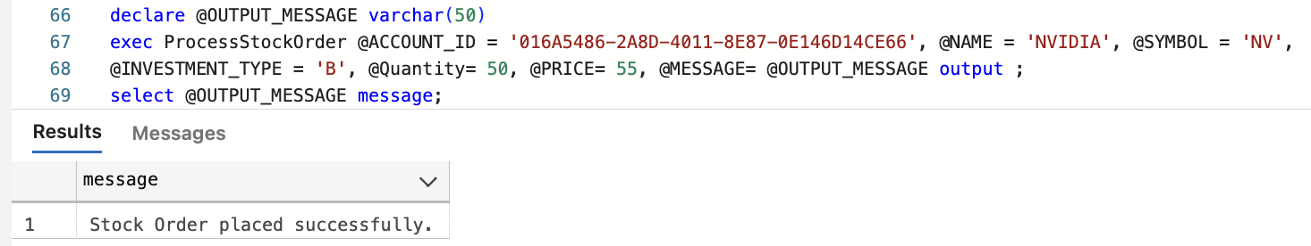
STORED PROCEDURE

Slide 5

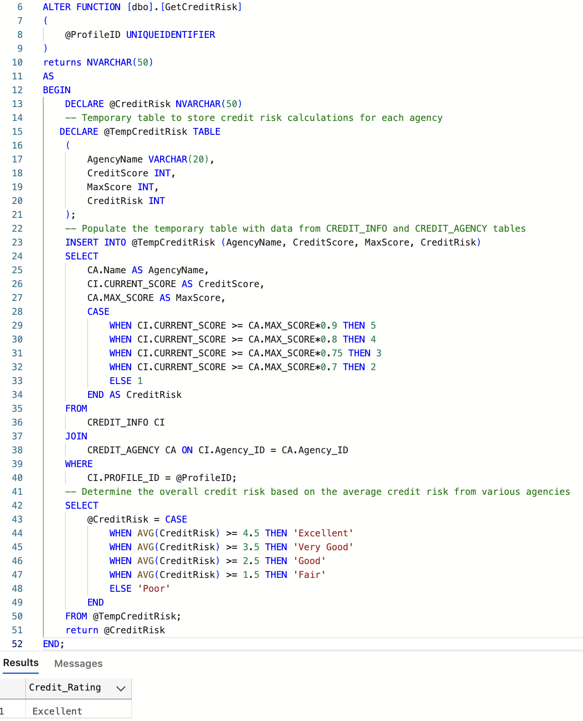
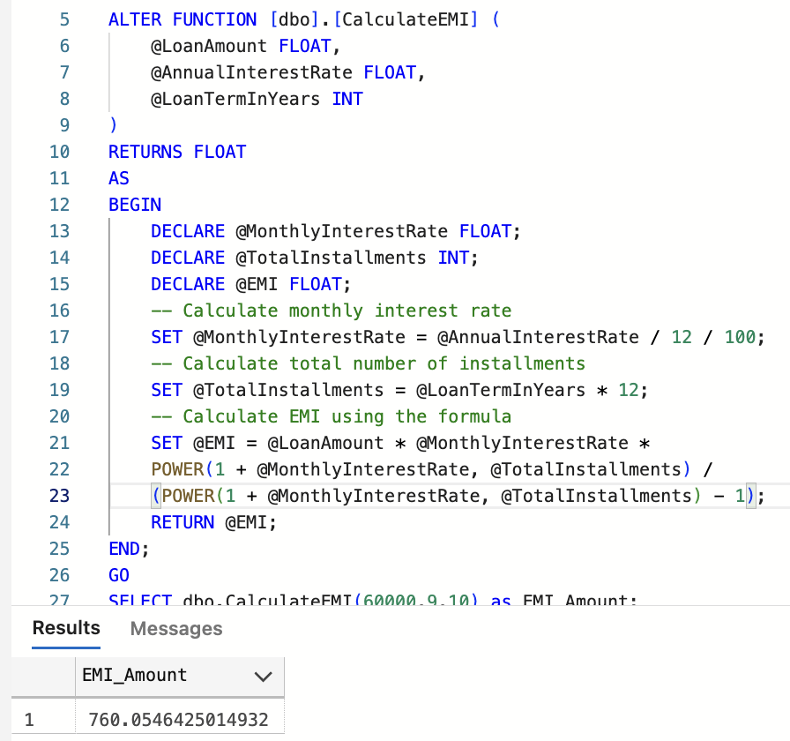

FUNCTION

Slide 6

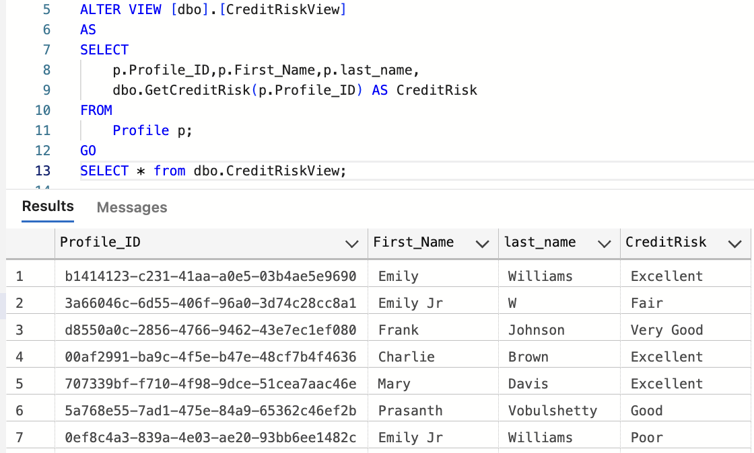
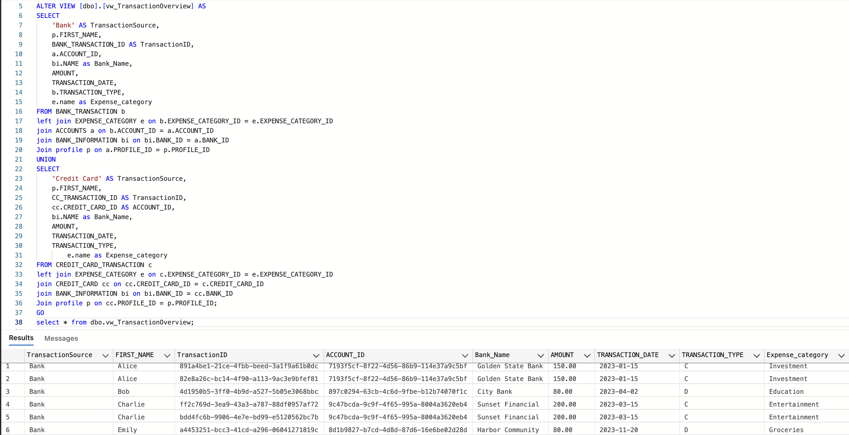
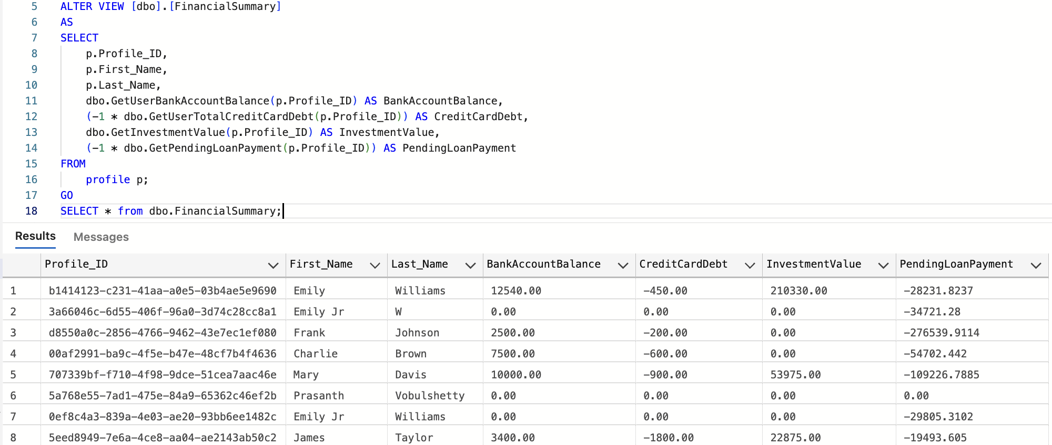
VIEWS

Slide 7
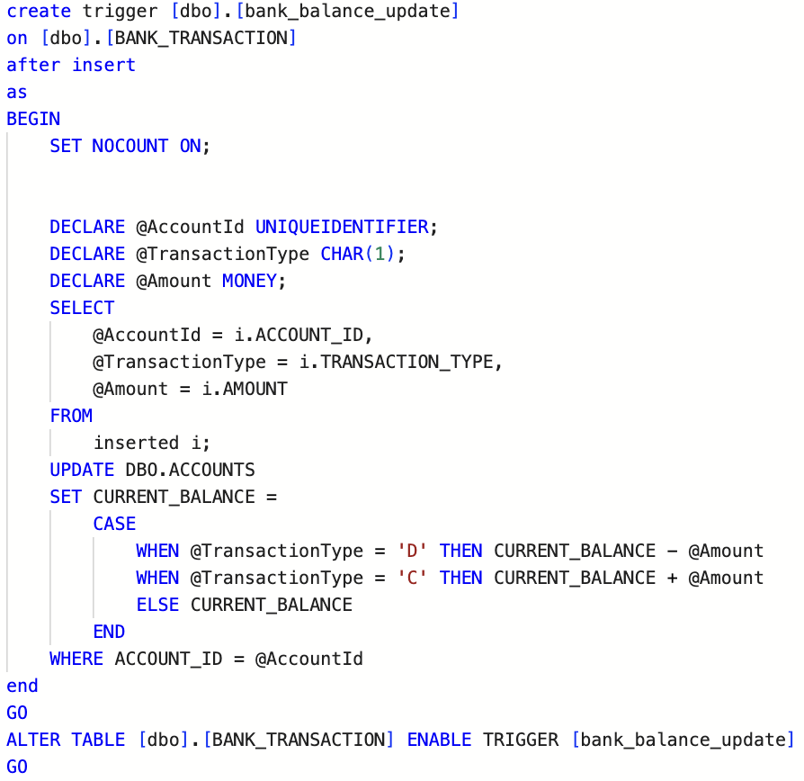
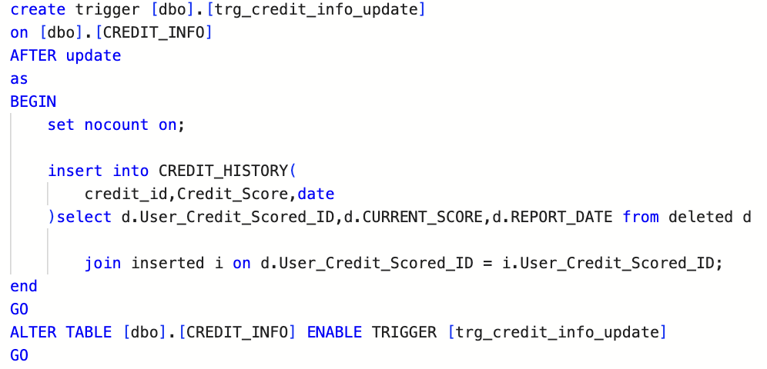

Triggers

Slide 8



Thank you!

